Slide 1
Assignment 5

Slide 2

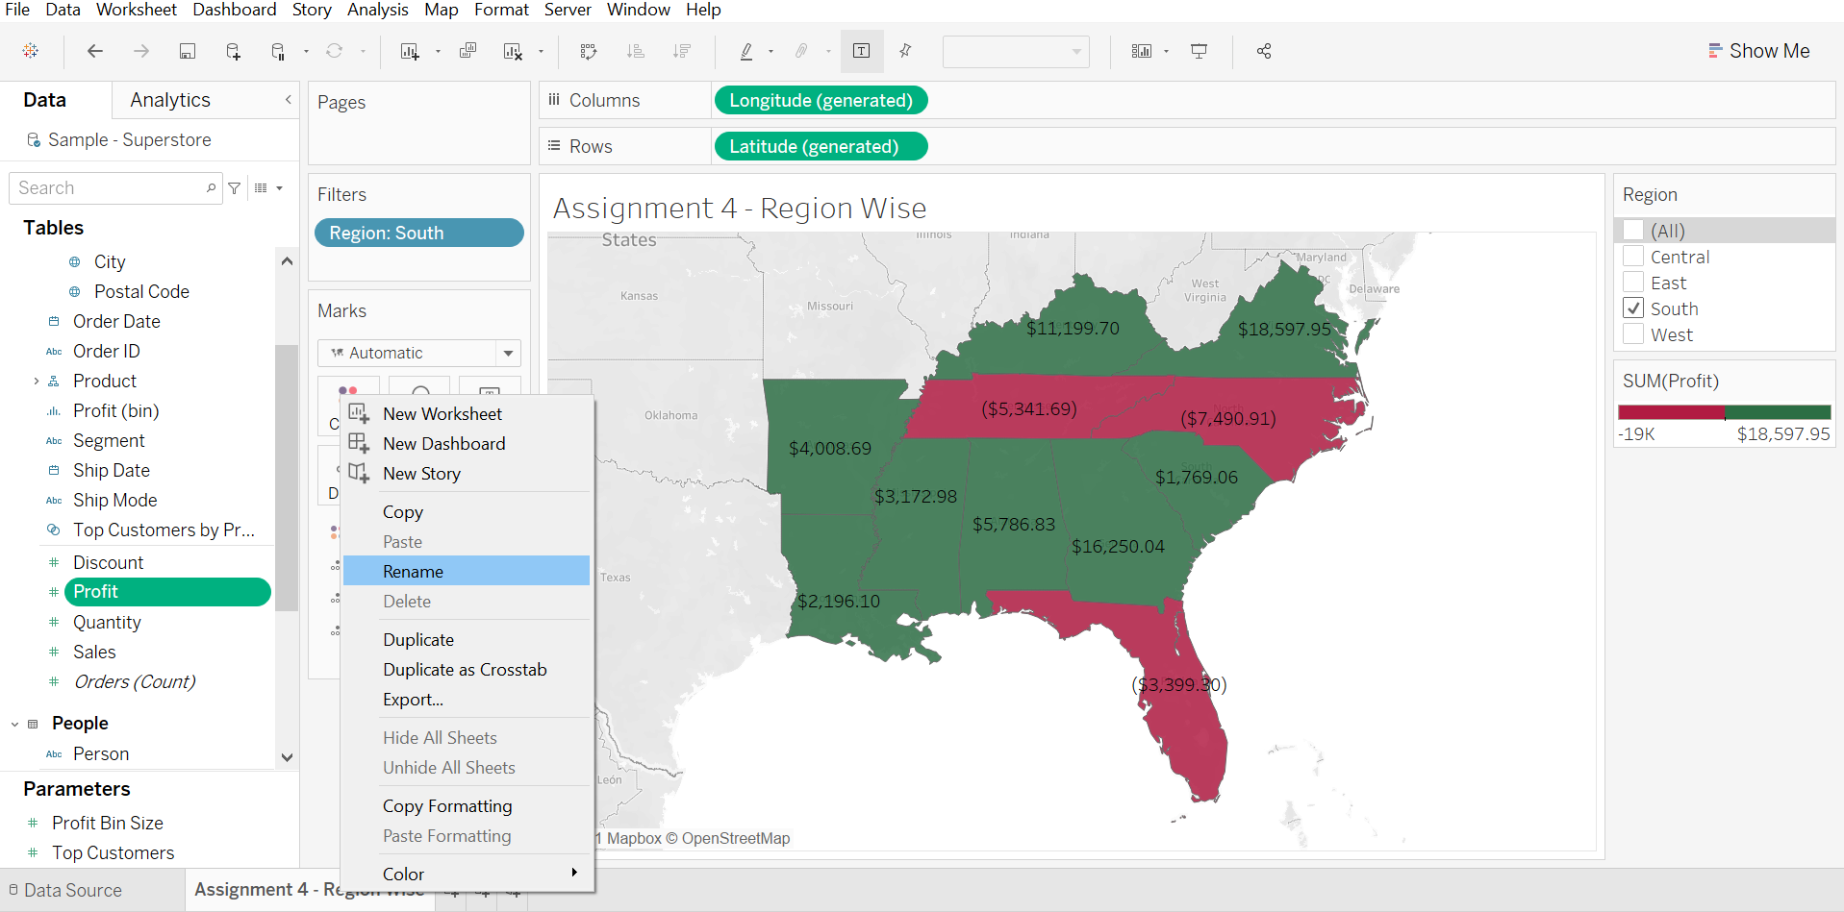
Duplicate the profit map and rename as negative profit map

Slide 3
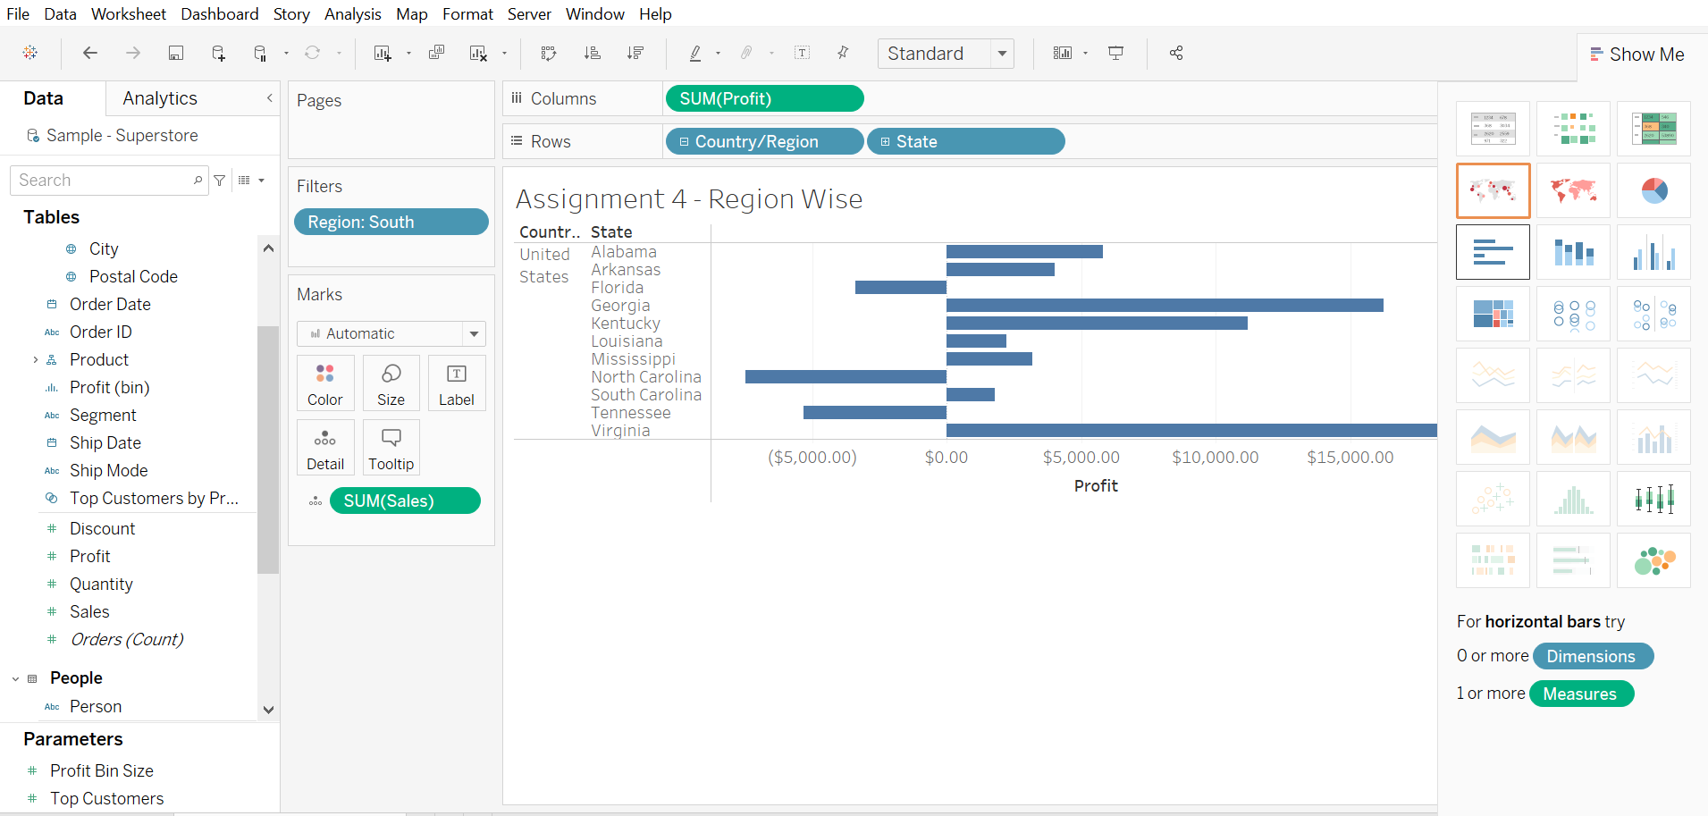
Represent profit map in horizontal bar format

Slide 4
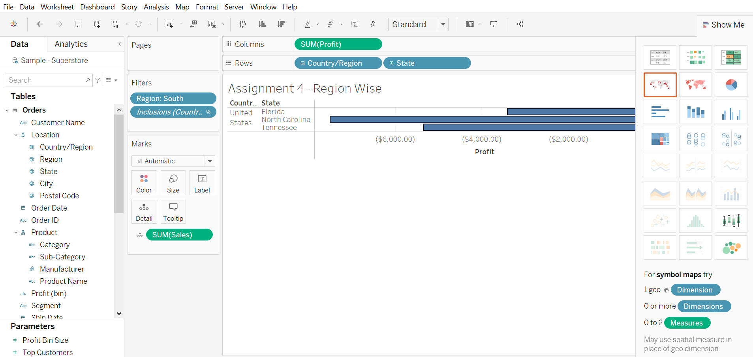
Show only the states having negative profit in the bar graph

Slide 5
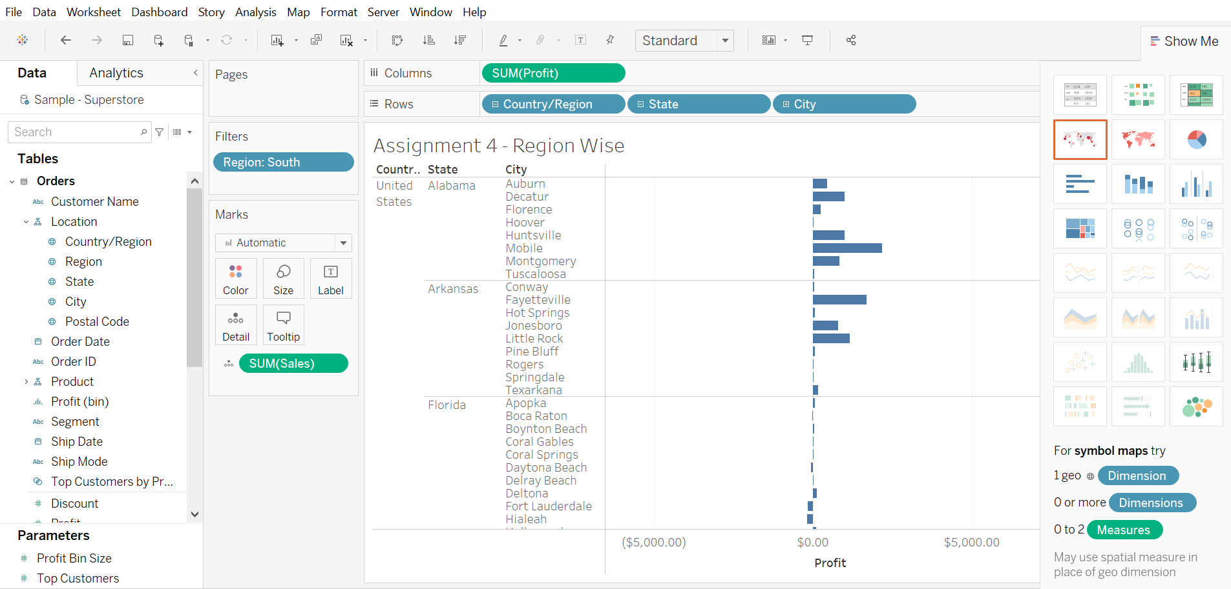
On the Rows shelf, click the plus icon on the state field to drill-down to the City level of detail.

Slide 6
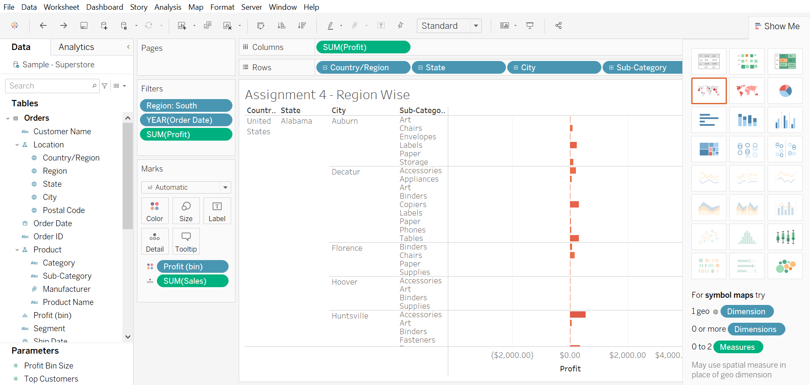
Show profit subcategory wise for all the states and city having negative profit

Slide 7
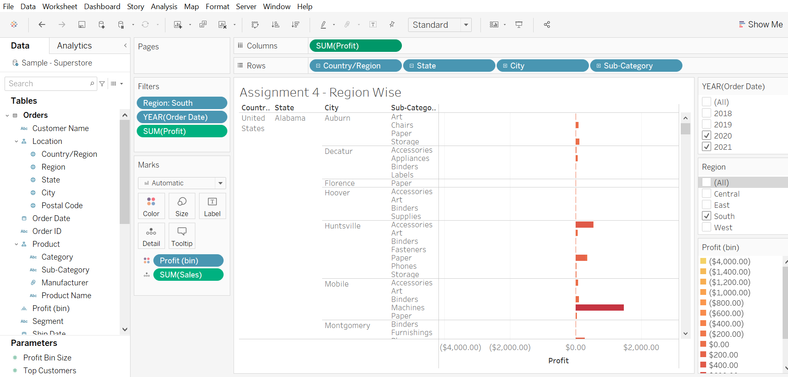
Check the profit in 2020 and 2021

